Slide 1
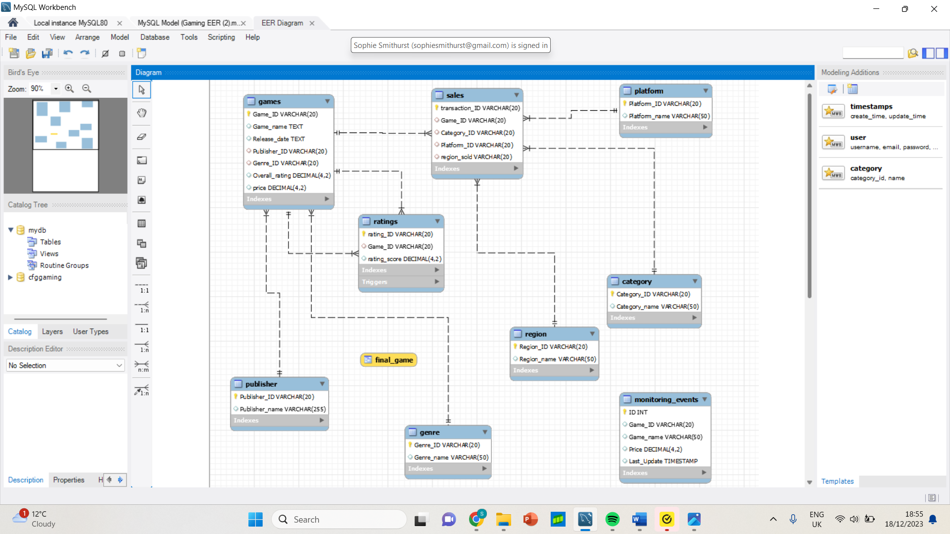
Project Gaming
Our project is for a gaming company, CFGGaming, whose aim is to break into the video game market and become a serious competitor.

Slide 2
Project Gaming Brief
We have been hired to collect data on game sales, different types of game genres, which platforms games are produced for, price of the products, amount sold and region of sales. This is collected from various sources which only include quantitative data.

Slide 3
Sophie
-- Stored Function - shows us which genres are most expensive, mid range and most afford
-- Group by and Having - counting number of games sold in each region.
-- View explanation
able

Slide 4
Dani
--- Add avg rating for each game to game table from ratings table
--- Trigger - Update overall_rating when a new rating is added
--- Subquery - Select sales by genre and their region
--- Event explanation

Slide 5
Helen
— Stored Procedure - Adding a new sales record
— Join - most sales by region
— Explain stored data from sales, games and ratings

